Slide 1

Unit 2.2 - The Internet
Prepared by: Koh Kian Hua

Slide 2
Objectives (Part 4)
After completing this unit, students should be able to:
Show understanding of the differences between the World Wide Web (WWW) and the internet
Describe the hardware that is used to support the internet.
Explain the use of IP addresses in the transmission of data over the internet
Explain how a Uniform Resource Locator (URL) is used to locate a resource on the World Wide Web (WWW) and the role of the Domain Name Service (DNS)

Slide 3
Computer Networks
Internet and World Wide Web
There are some: fundamental differences between the Internet and World Wide Web
Internet:
A massive network of networks which are made up of various computers and other electronic devices.
It stands for interconnected network.
The internet makes use of transmission control protocol (TCP)/internet protocol (IP).
The World Wide Web (WWW):
A collection of multimedia web pages and other documents which are stored on websites.
http(s) protocols are written using HyperText Mark-up Language (HTML).
Uniform resource locators (URLs) specify the location of all web pages.
Web resources are accessed by web browsers.
The world wide web uses the internet to access information from servers and other computers.

Slide 4
Computer Networks
Hardware and software to support the internet
Requirements for connecting to the internet are:
a device (such as a computer, tablet or mobile phone)
a telephone line connection or a mobile phone network connection
a router (which can be wired or wireless) or router and modem
an internet service provider (ISP) (combination of hardware and software)
a web browser.

Slide 5
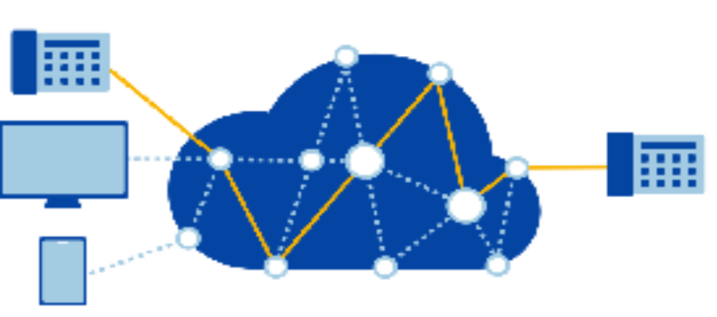
Computer Networks
Public Switch Telephone Network (PSTN)
A combination of telephone networks used worldwide, including telephone lines, fiber optic cables, switching centers, cellular networks, satellites and cable systems. A PSTN lets users make landline telephone calls to one another

Slide 6
Computer Networks
PSTN phone call and Internet phone call
PSTN Call
PSTNs are all about circuit switching. When a call is made, switches create a wire circuit between two telephones, with this particular connection lasting as long as the duration of the call.
PSTN uses a standard telephone connected to a telephone line.
The telephone line connection is always open whether or not anybody is talking
Telephone lines remain active even during a power cut; they have their own power source.
Internet Phone Call
Phone calls using the internet use either an internet phone or microphone and speakers
The internet connection is only ‘live’ while data (sound/video image) is being transmitted.
VoIP converts sound to digital packages (encoding) which can be sent over the internet.
VoIP uses packet switching; the networks simply send and retrieve data as it is needed so there is no dedicated line, unlike PSTN.
Data is routed through many possible pathways, allowing the fastest route to be determined.
The conversation (data) is split into data packages with duch sender’s address, receiver’s address and order number of packet

Slide 7
Computer Networks
Cellular Networks and Satellites
Cellular Networks
Mobile phones use the cellular network.
The mobile phone providers act as the ISPs and the phones contain communication
software which allows them to access the telephone network and also permits them to make an internet connection.
Satellites
Satellites are an important part of all network communications that cover vast distances.
Satellites have the advantage that they will always give complete coverage and don’t suffer from signal attenuation to the same extent as underground / undersea cables.
It is also difficult to isolate and resolve faults in cables on the sea bed.

Slide 8
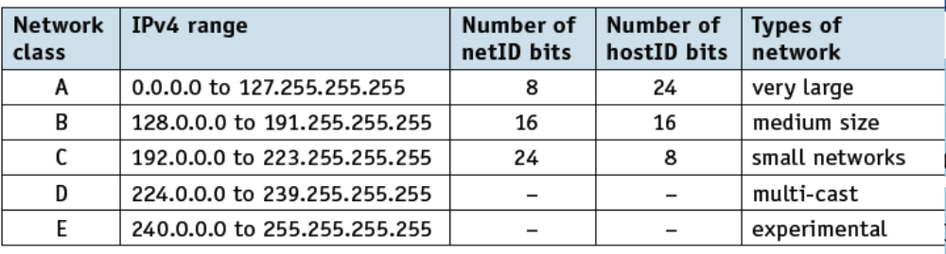
Computer Networks
Internet Prototop; IPv4 Addressing
The most common type of addressing on the internet is IP version 4 (IPv4).
This is based on 32 bits giving 232 (4 294 967 296) possible addresses.
The 32 bits are split into four groups of 8 bits (thus giving a range of 0 to 255).
The system uses the group of bits to define network (netID) and network host
(hostID).
The netID allows for initial transmission to be routed according to the netID and then the hostID is looked at by the receiving network.
There are 5 Network classes

Slide 9
Computer Networks
Parts of IP Address
The bytes of the IPv4 address are further classified into two parts:
the network part and
the host part.
For example, a class B network IP address 128.148.12.14, can be written
in binary as:
10000000 10010100 00001100 00001110
The network ID is 128.148 and the host ID is 12.14 (made up of sub-net ID of 12 and host ID of 14).

Slide 10
Computer Networks
Parts of IP Address (IPv4)
Another Example: a class A network exhibits the following charateristics:
8 netID bits
24 hostID bits.
In this example, class A network IP address 29. 68. 0. 43, can be written
in binary as:
00011101 01000100 00000000 00101011
The network ID is 29 and the host ID is 68.0.43 (made up of sub-net ID of 68.0 and host ID of 43).

Slide 11
Computer Networks
IPv6 Addressing
IPv6 addressing has the following charcateristics:
Uses 128-bit addressing, which supports more complex addressing structures compared to IPv4.
It is broken into 16-bit chunks and adopts the hexadecimal notation.
For example:
A8FB:7A88:FFF0:0FFF:3D21:2085:66FB:F0FA
Note that a colon (:) rather than a decimal point (.) is used here.
.

Slide 12
Computer Networks
Benefits of IPv6 Addressing
IPv6 is is designed to allow the internet to grow in terms of number of hosts and the potential amount of data traffic.
IPv6 has several benefits over IPv4:
It has no need for NATs (network address translation)
It removes risk of private IP address collisions
It has built in authentication
It allows for more efficient routing.
.

Slide 13
Computer Networks
Zero Compression
IPv6 addresses can be quite long; and can be shortened using zero compression.
For example, 900B:3E4A:AE41:0000:0000:AFF7:DD44:F1FF can be written as: 900B:3E4A:AE41::AFF7:DD44:F1FF
With the section 0000:0000 replaced by ::
The zero compression can only be applied ONCE on IPv6 address.
For example, 8055:F2F2:0000:0000:FFF1:0000:0000:DD04
can be rewritten either as:
8055:F2F2::FFF1:0000:0000:DD04
or as:
8055:F2F2:0000:0000:FFF1::DD04
.

Slide 14
Computer Networks
Subnetting
Sub-netting divides a LAN into two or more smaller networks. This helps reduce network traffic and can also hide the complexity of the overall network.
The IP address (using IPv4) is made up of the netID and hostID. Suppose a university network has eight departments and has a netID of 192.200.20 (11000000.11001000.00010100).
All of the devices on the university network will be associated with this netID and can have hostID values from 00000001 to 11111110 (hostIDs containing all 0s or all 1s are forbidden).
.

Slide 15
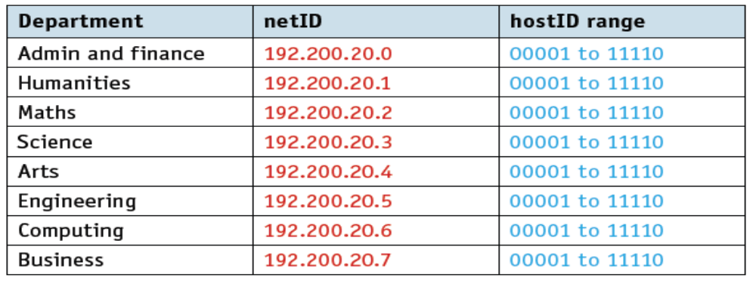
Computer Networks
Subnetting
With sub-netting, the hostID is split as follows: 000 00000, where the first 3 bits are netID expansion and the last 5 bits are the hostIDs. Thus, we have eight sub-nets with the same range of hostIDs.
The devices in the Admin and finance department will have IP addresses
  192.200.20.000 00001 to 192.200.20.000 11110
The Humanities department will have IP addresses
  192.200.20.001 00001 to 192.200.20.001 11110
.

Slide 16
Computer Networks
Private IP addresses and public IP addresses
Private IP addresses are reserved for internal use behind a router or other NAT(Network Address Translation) device.They allow access to the network without taking up a public IP address space. However, devices using these private IP addresses cannot be reached by internet users.
The following blocks are reserved for private IP addresses.
  Class A: 10.0.0.0 to 10.255.255.255
  Class B: 172.16.0.0 to 172.31.255.255
  Class C: 192.168.0.0 to 192.168.255.255
Public IP addresses are allocated by a user’s ISP to identify the location of their device. Devices using these IP addresses are accessible from anybody using the internet. Public IP addresses are used by
  DNS servers
  network routers
  directly-controlled computers.
.

Slide 17
Computer Networks
Uniform Resource Locators (URL)
Web browsers are software that allow users to access and display web pages on their screens. They interpret HTML sent from websites and display the results.
Web browsers use uniform resource locators (URL) to access websites; these are represented by a set of four numbers, such as 109.108.158.1.
It is also possible to type this into a browser using the following format:
protocol://website address/path/filename
Protocol is usually http or https
Website address is
domain host (www)
domain name (name of website)
domain type (.com, .org, .net, .gov, and so on)
(sometimes) a country code (.uk, .de, .cy, .br, and so on).
Example is: http://www.nus.edu.sg
.

Slide 18
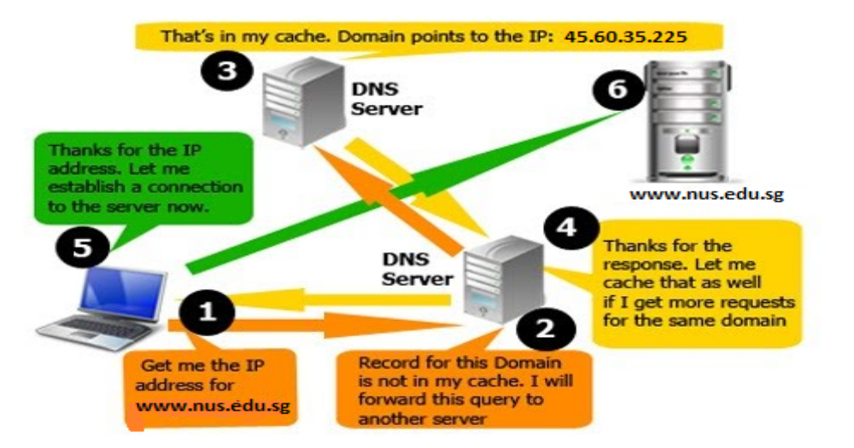
Computer Networks
Domain Name Service (DNS)
The domain name service (DNS) gives domain names for internet hosts and is a system for finding IP addresses of a domain name.
The DNS process involves converting a host name (such as www.nus.edu.sg) into an IP address the computer can understand (such as 45.60.35.225).
.

Slide 19
Computer Networks
Class Activity
1) Describe the differences between private IP addresses and public IP addresses.
2) Identify the protocol, domain name, domain type and country code used in the following URL: http://www.smu.edu.sg
3) Describe how DNS is used to retrieve a web page from the website
used in Q2.
.

